Slide 1
Silver Linings: How a Data Harmonisation Mishap Turned into a PhD Thesis
Cynthia Huang
PhD Candidate at Monash University, Australia

Slide 2
A “Straightforward” Concordance Task
UNIDO Industrial Statistics Database at the 4-digit level of ISIC (INDSTAT4) contains highly disaggregated data on the manufacturing sector for the period 1990 onwards

Slide 3
Once upon a time…
Notes:
My story starts just like any other data story…

Slide 4
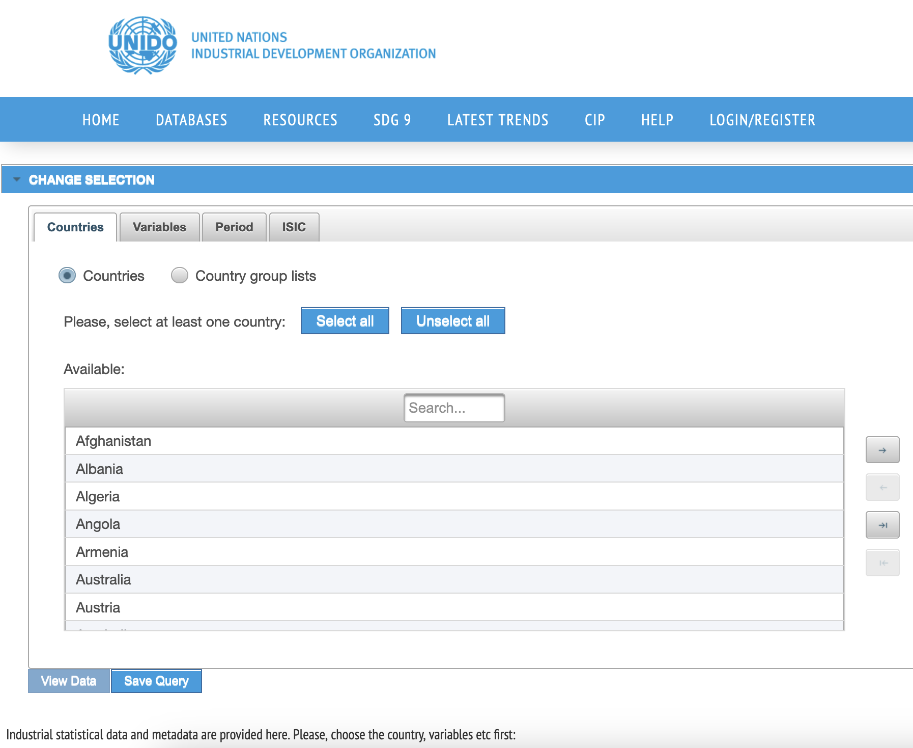
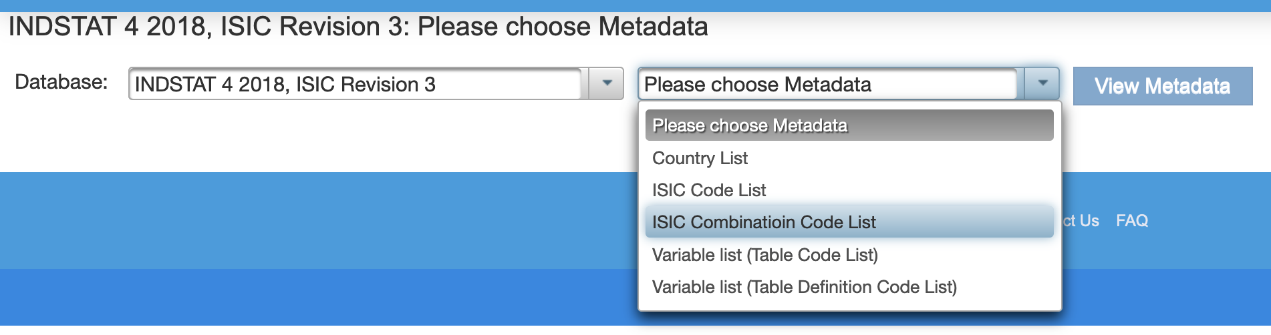
Collecting data…
INDSTAT4_datasets/
├── REV_3/
│ ├── data/
│ │ ├── 01-Establishments.csv
│ │ ├── 04-Employees.csv
│ │ ├── 05-Wages and salaries.csv
│ │ ├── 14-Output.csv
│ │ ├── 20-Value added.csv
│ │ ├── 21-Gross fixed capital formation.csv
│ │ └── 31-Female employees.csv
│ ├── lookups/
│ │ ├── countries.csv
│ │ ├── isics.csv
│ │ └── variables.csv
│ └── raw-exports/
│ ├── QUERY-dbinfo-INDSTAT 4 2019, ISIC Revision 3.txt
│ └── export20191121081134_787247ee-…-f7f27cd5fca3.zip
├── REV_4/
│ ├── data/
│ │ ├── 01-Establishments.csv
│ │ ├── 04-Employees.csv
│ │ ├── 05-Wages and salaries.csv
│ │ ├── 14-Output.csv
│ │ ├── 20-Value added.csv
│ │ ├── 21-Gross fixed capital formation.csv
│ │ └── 31-Female employees.csv
│ ├── lookups/
│ │ ├── countries.csv
│ │ ├── isics.csv
│ │ ├── utable.csv
│ │ └── variables.csv
│ └── raw-exports/
│ ├── QUERY-dbinfo-INDSTAT 4 2019, ISIC Revision 4.txt
│ ├── export20191121081637_32b0b7ba-…-01b3deecdfa4.zip
│ └── export20191121160821_01ff5523-…-45f382e4fdad.xlsx
├── readme.txt
└── reference/
├── code/
│ ├── functions.R
│ ├── parse_csv.R*
│ └── parse_xlsx.R
└── unido/
├── GettingStarted.pdf
├── INDSTAT4-Rev3_Description.pdf
├── INDSTAT4-Rev4_Description.pdf
├── unido-REV3-xlsx-error.png
├── unido-REV4-xlsx-export.png
└── unido-csv-export.png
Collect
Notes:
getting the data. But we’re going to breeze past all that pain because that’s just the prelude to my mishap

Slide 5
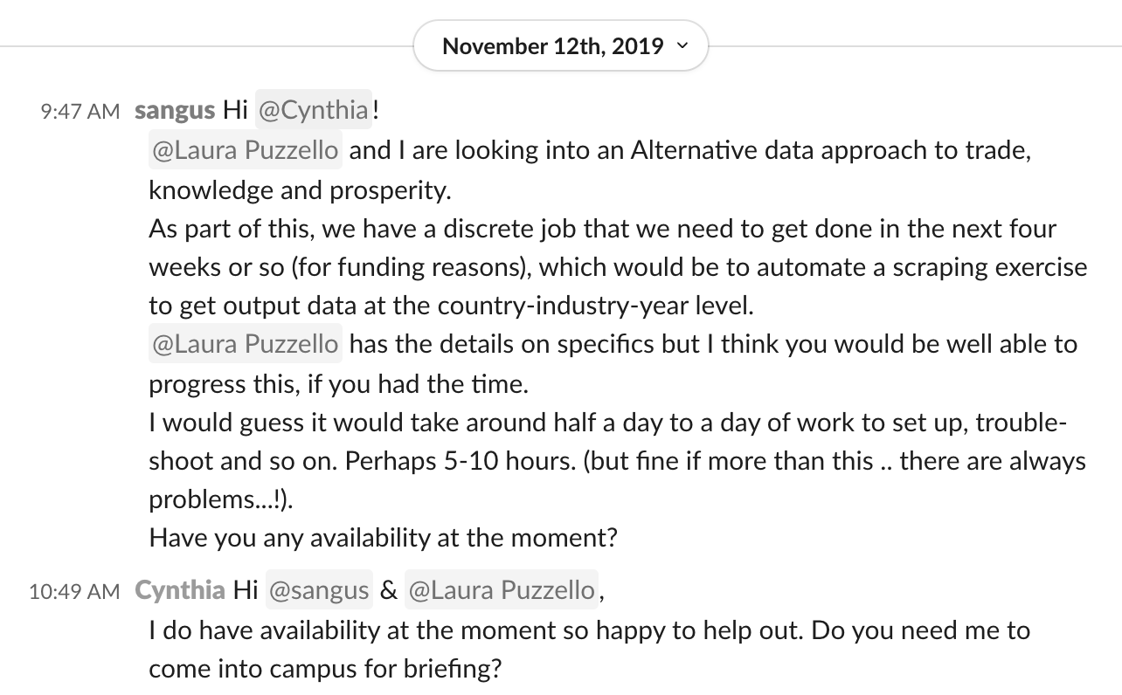

I was a SoDa Labs RA…
Notes:
I was an economist at SoDa Labs Monash University, and I received this slack message, asking me if I could help prepare some data for an alternative data approach to researching Trade, Knowedge and Prosperity… It was only 5-10hours of work (famous last words), so I said yes of course I could help out, and thus my data mishap story began like any good data story…

Slide 6
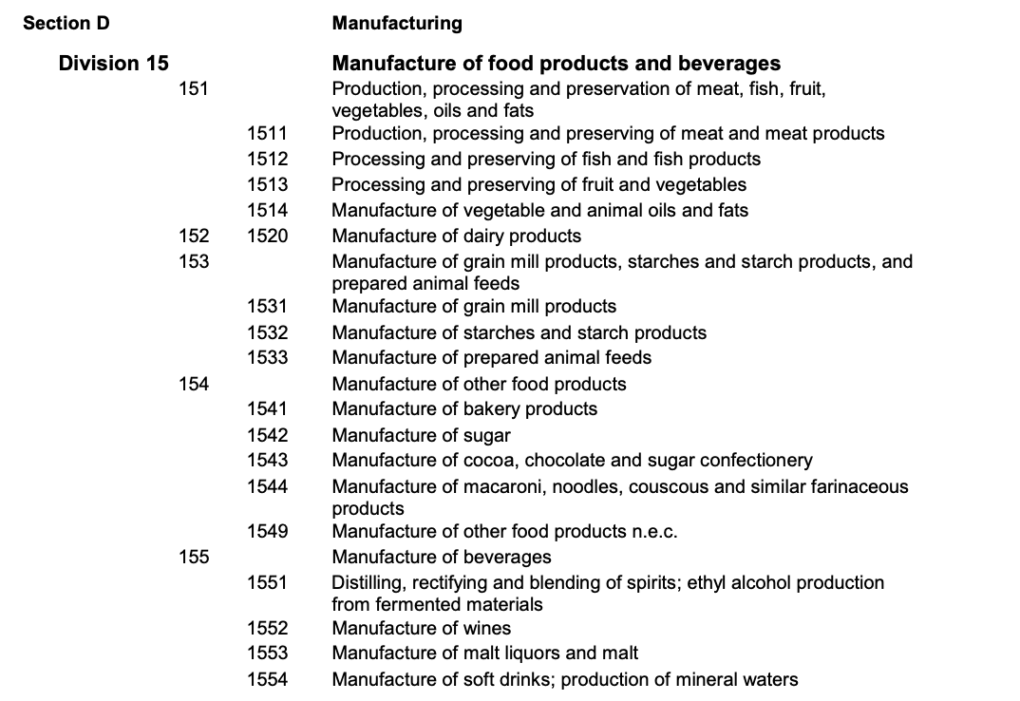
Collecting data…
Collect
Notes:
With the pain of collecting data… but that’s not the point of this story, so let’s just snap our fingers and skip straight to having

Slide 7
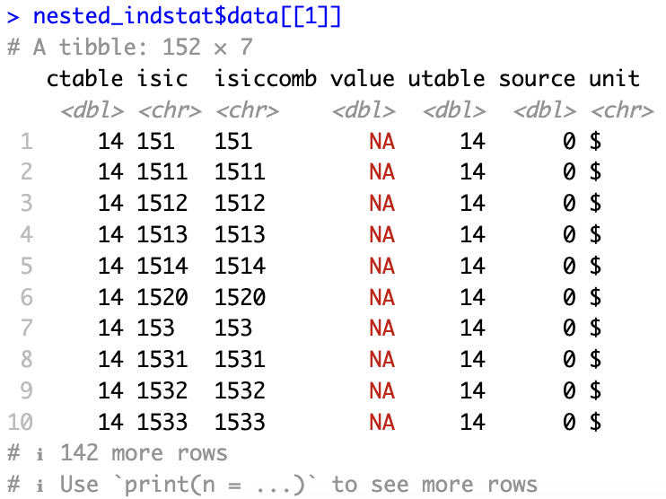
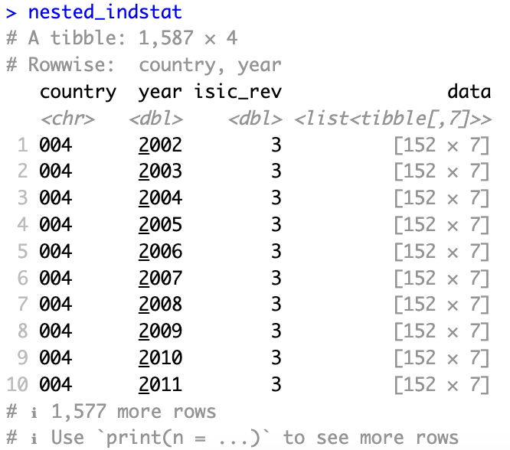
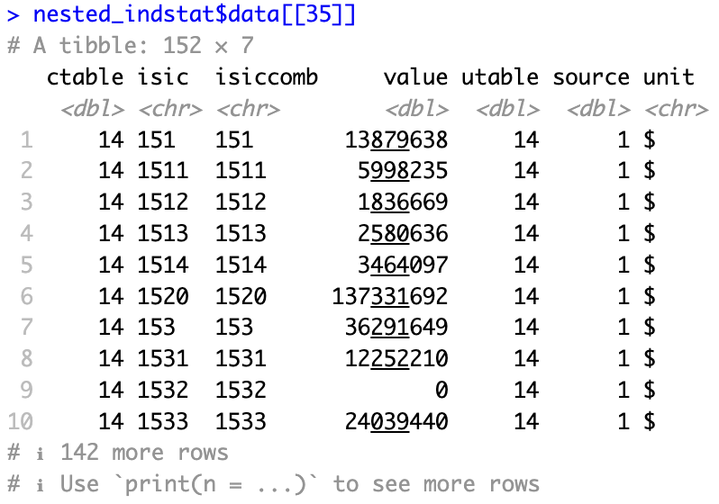
Importing data…
│ │ ├── 14-Output.csv
Collect
Import & Prepare
Notes:
country, year output statistics, broken down by industry…

Slide 8
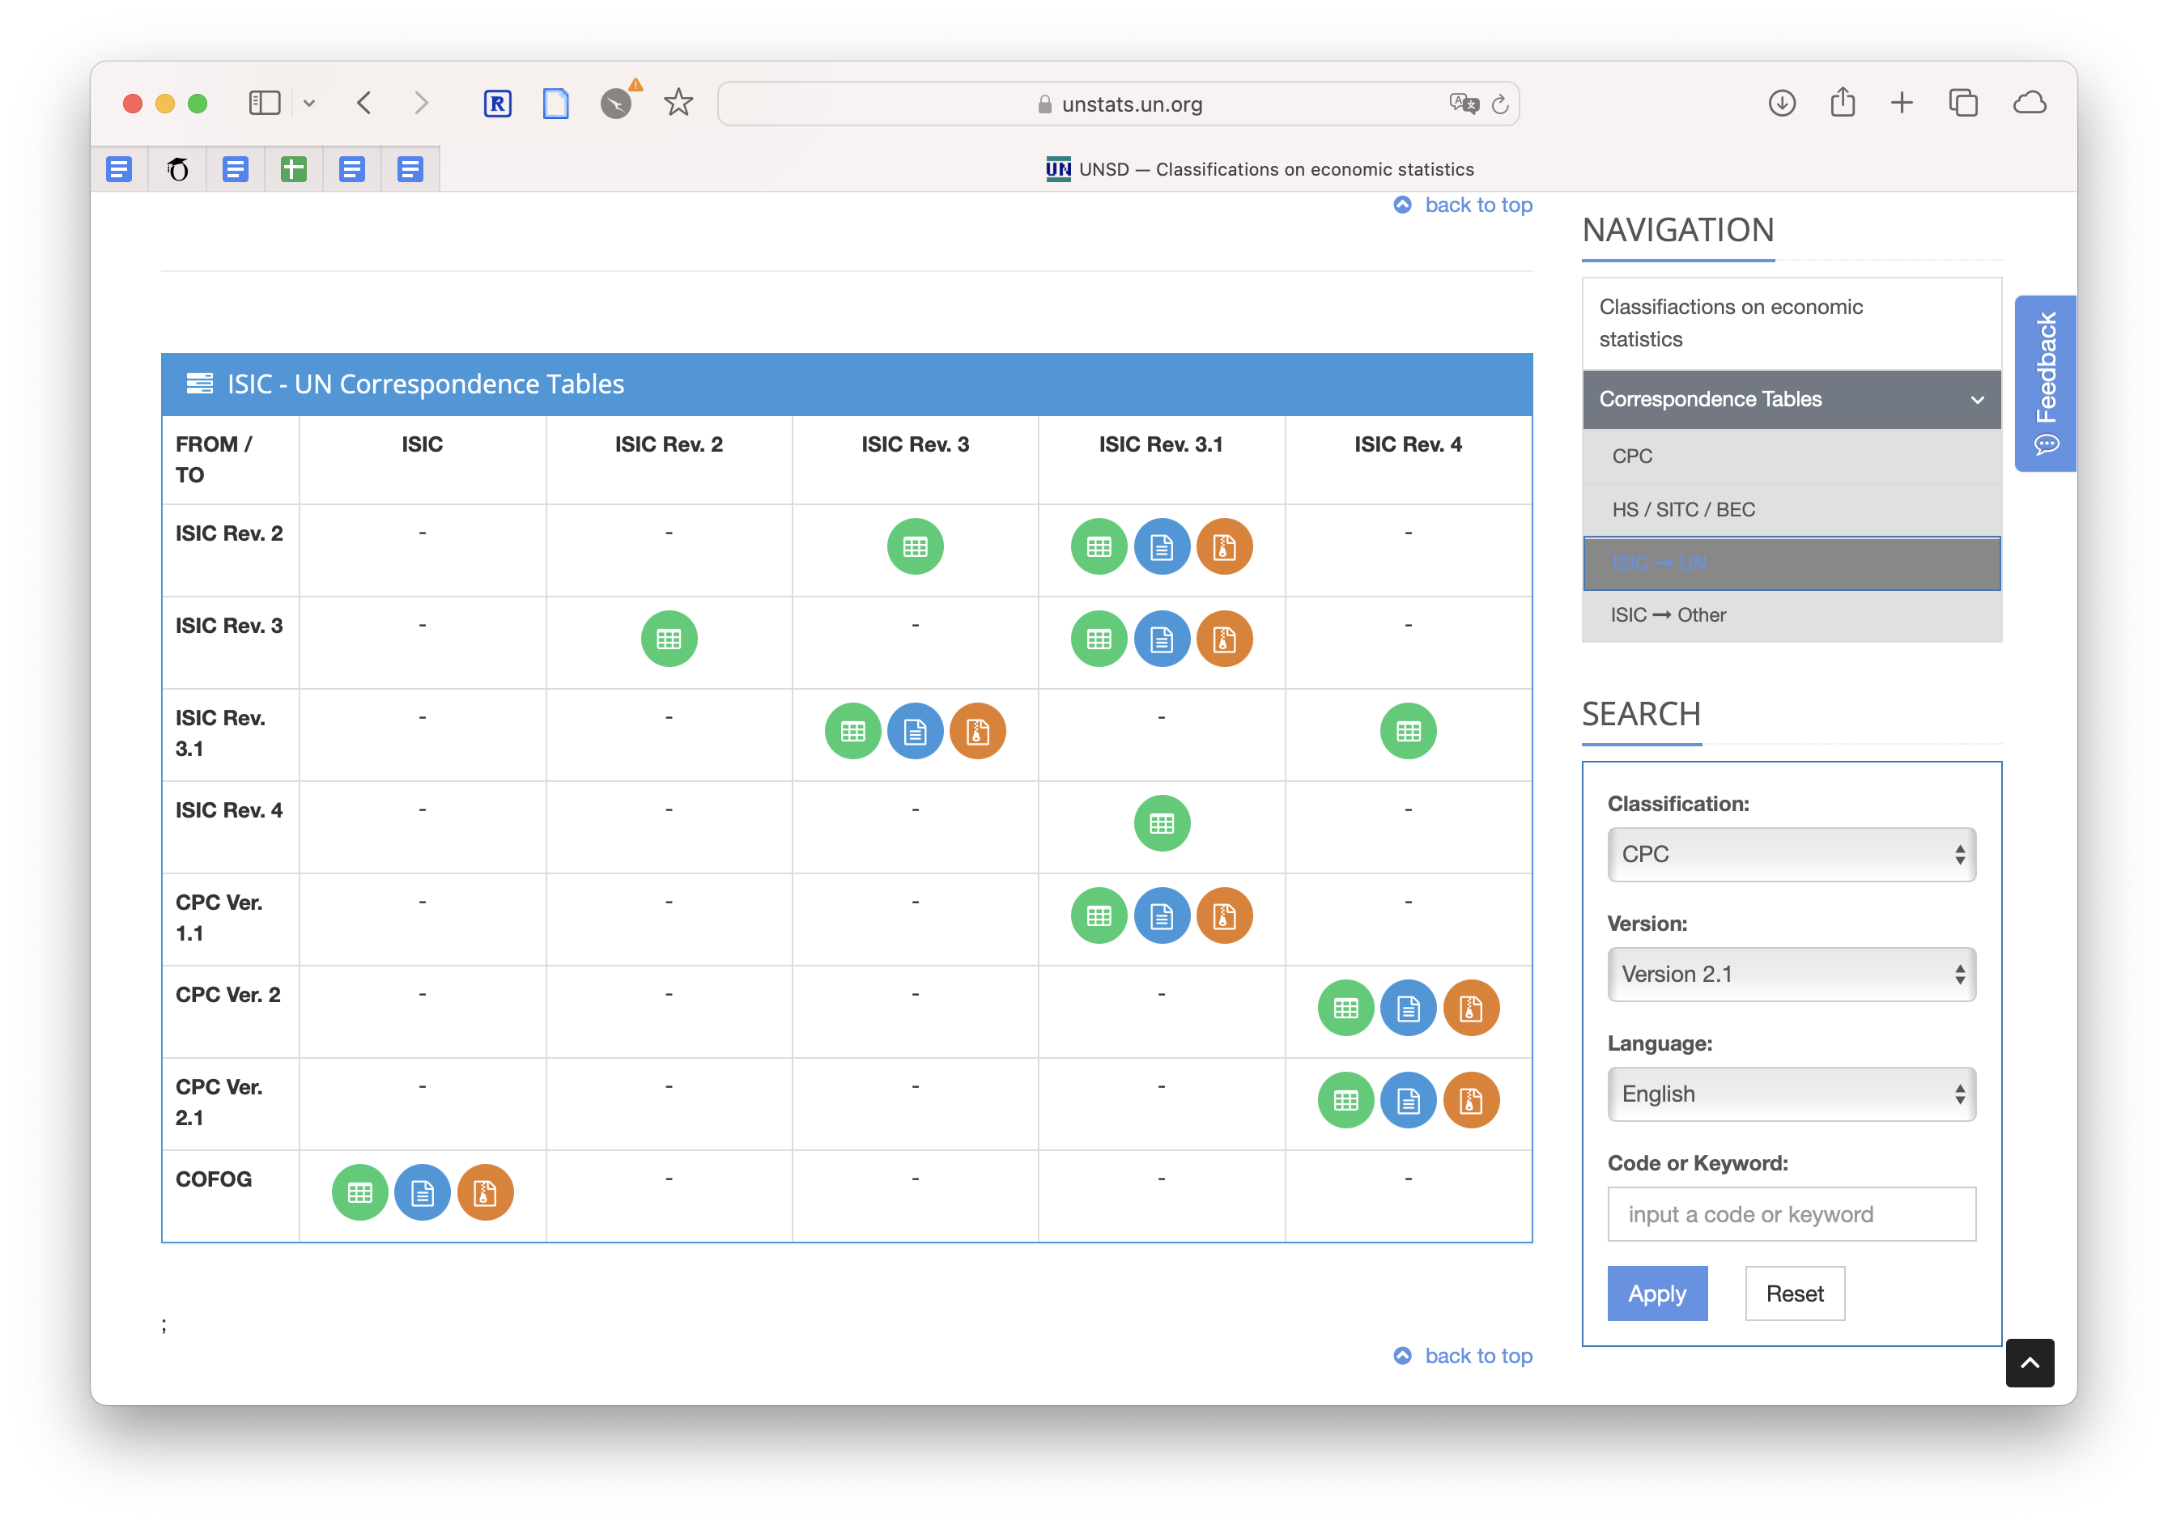
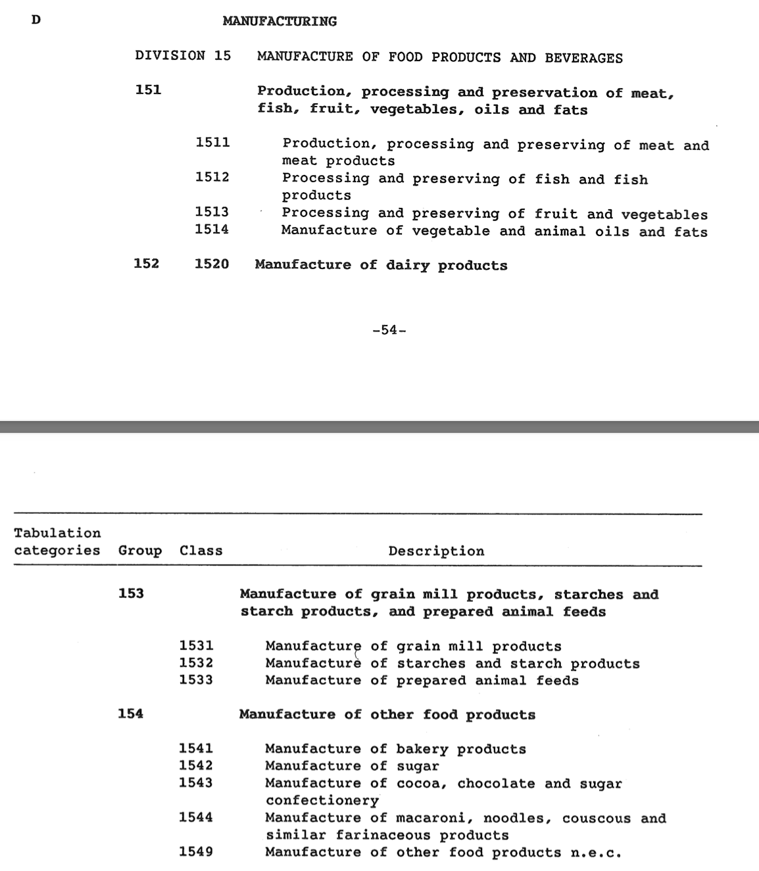
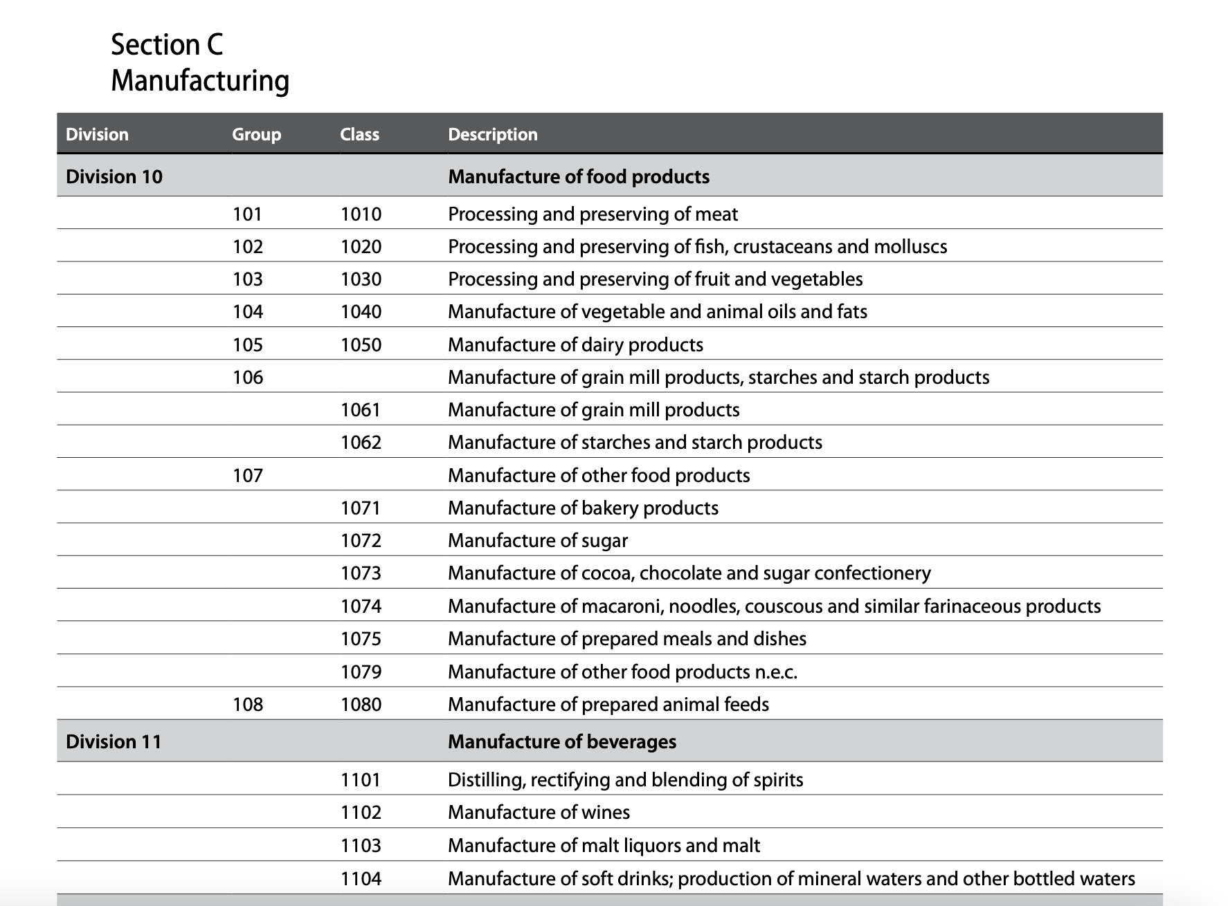
Conversion needed!
Collect
Import & Prepare
Notes:
Unfortunately, the data couldn’t be used straight away because the industry classification codes changed over the years and some countries adopt the revisions faster than others, while others decide to use variations on the international standard. The upshot is that if you want to analyse trends over time, you need to resolve these classification changes. Luckily for us, UN stats kindly provides selected correspondence tables between revisions…

Slide 9
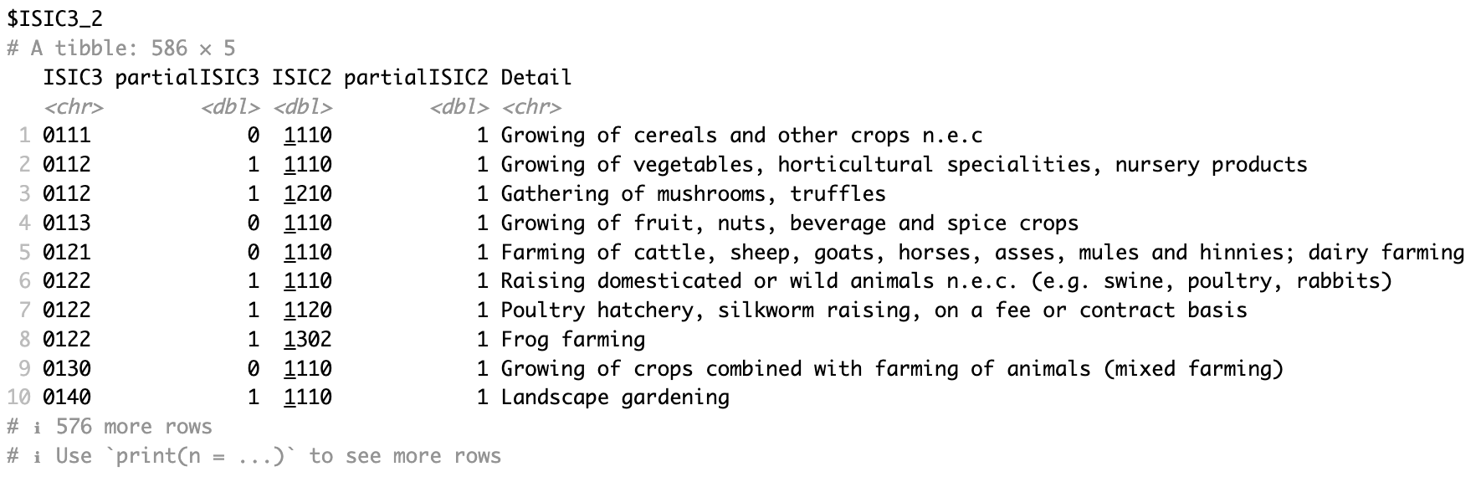
Ready to harmonise…
data/
├── external/
│ ├── TPP_data/
│ │ ├── TPP_rev1_76-90.csv
│ │ └── TPP_rev1_91-04.csv
│ ├── concordances/
│ │ ├── ISIC3-ISIC2.txt
│ │ ├── ISIC_3.1_3_note.htm
│ │ ├── ISIC_Rev_2-ISIC_Rev_3_1_correspondence.txt
│ │ ├── ISIC_Rev_31-ISIC_Rev_3_correspondence.txt
│ │ ├── ISIC4_ISIC31.txt
│ │ └── isicTables_2020-05-15.Rds
└── raw/
└── datasets/
├── REV_3/
│ └── 14-Output.csv
└── REV_4/
└── 14-Output.csv
Collect
Import & Prepare
Notes:
… so in theory I had everything I needed – the raw data, logic for mapping between ISIC revisions… all I needed to do was *just* code it up.

Slide 10
Ready to harmonise…
data/
├── external/
│ ├── TPP_data/
│ │ ├── TPP_rev1_76-90.csv
│ │ └── TPP_rev1_91-04.csv
│ ├── concordances/
│ │ ├── ISIC3-ISIC2.txt
│ │ ├── ISIC_3.1_3_note.htm
│ │ ├── ISIC_Rev_2-ISIC_Rev_3_1_correspondence.txt
│ │ ├── ISIC_Rev_31-ISIC_Rev_3_correspondence.txt
│ │ ├── ISIC4_ISIC31.txt
│ │ └── isicTables_2020-05-15.Rds
│ └── country_codes/
│ ├── INDSTAT_countries_REV3.csv
│ ├── INDSTAT_countries_REV4.csv
│ └── TPP_countrynames.out
├── final/
│ ├── matched_country_lookup.csv
│ └── matched_output.csv
├── interim/
│ ├── 001-clean_INDSTAT.Rds
│ ├── 002-INDSTAT_ISIC2_3digit_2020-05-15.Rds
│ ├── 002-isicTables_2020-05-15.Rds
│ ├── 003-matched_country_lookup.Rds
│ └── 003-matched_tpp_indstat.Rds
└── raw/
└── datasets/
├── REV_3/
│ └── 14-Output.csv
└── REV_4/
└── 14-Output.csv
Collect
Import & Prepare
Notes:
Things were a little more complicated with REV4… but in theory I had everything I needed – the raw data, logic for mapping between ISIC revisions… all I needed to do was *just* code it up.

Slide 11
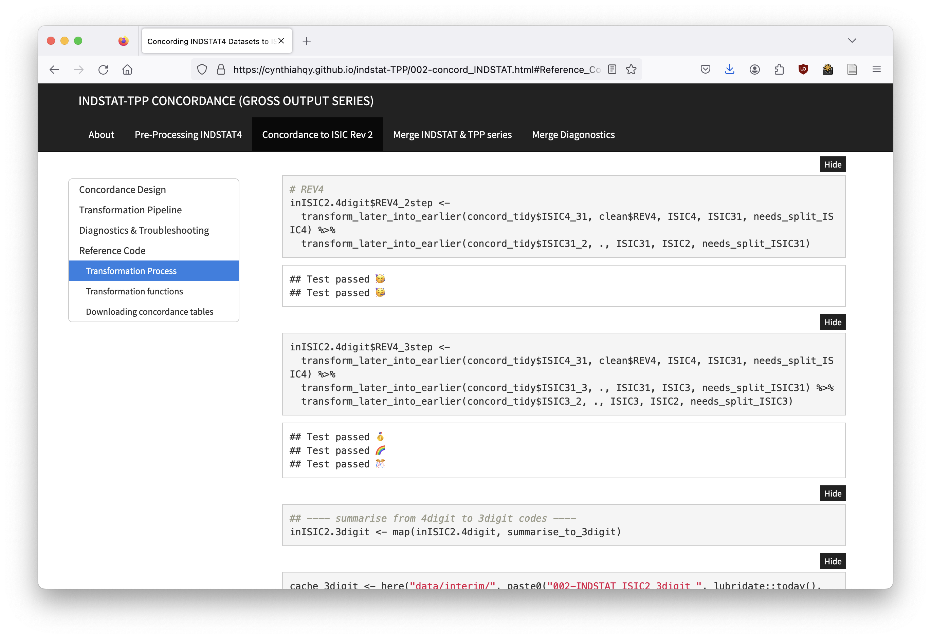
Running scripts…
.
├── ISIC_concordance.Rproj
├── README.md
├── code
│ ├── fncs_cleaning.R
│ ├── fncs_concordance.R
│ ├── fncs_matchTPP.R
│ ├── fncs_probing.R
│ └── get_concordance_tables.R
├── data
│ ├── archived
│ ├── external
│ ├── final
│ ├── interim
│ └── raw
├── notebooks
│ ├── 001-clean_INDSTAT.Rmd
│ ├── 002-concord_INDSTAT.Rmd
│ ├── 003-match_TPP_INDSTAT.Rmd
│ └── 004-compare-matched.Rmd
└── reference
├── ISIC manuals
├── TPP database
├── country codes
└── unido-metadata
Collect
Import & Prepare
Harmonise
Notes:
So that’s what I did, I took the correspondence tables and turned them into R functions and scripts. Not only did I do that, but I also meticulously documented what I did, kept my project folder neat and tidy, and even tested things like row numbers and totals as I went along!

Slide 12
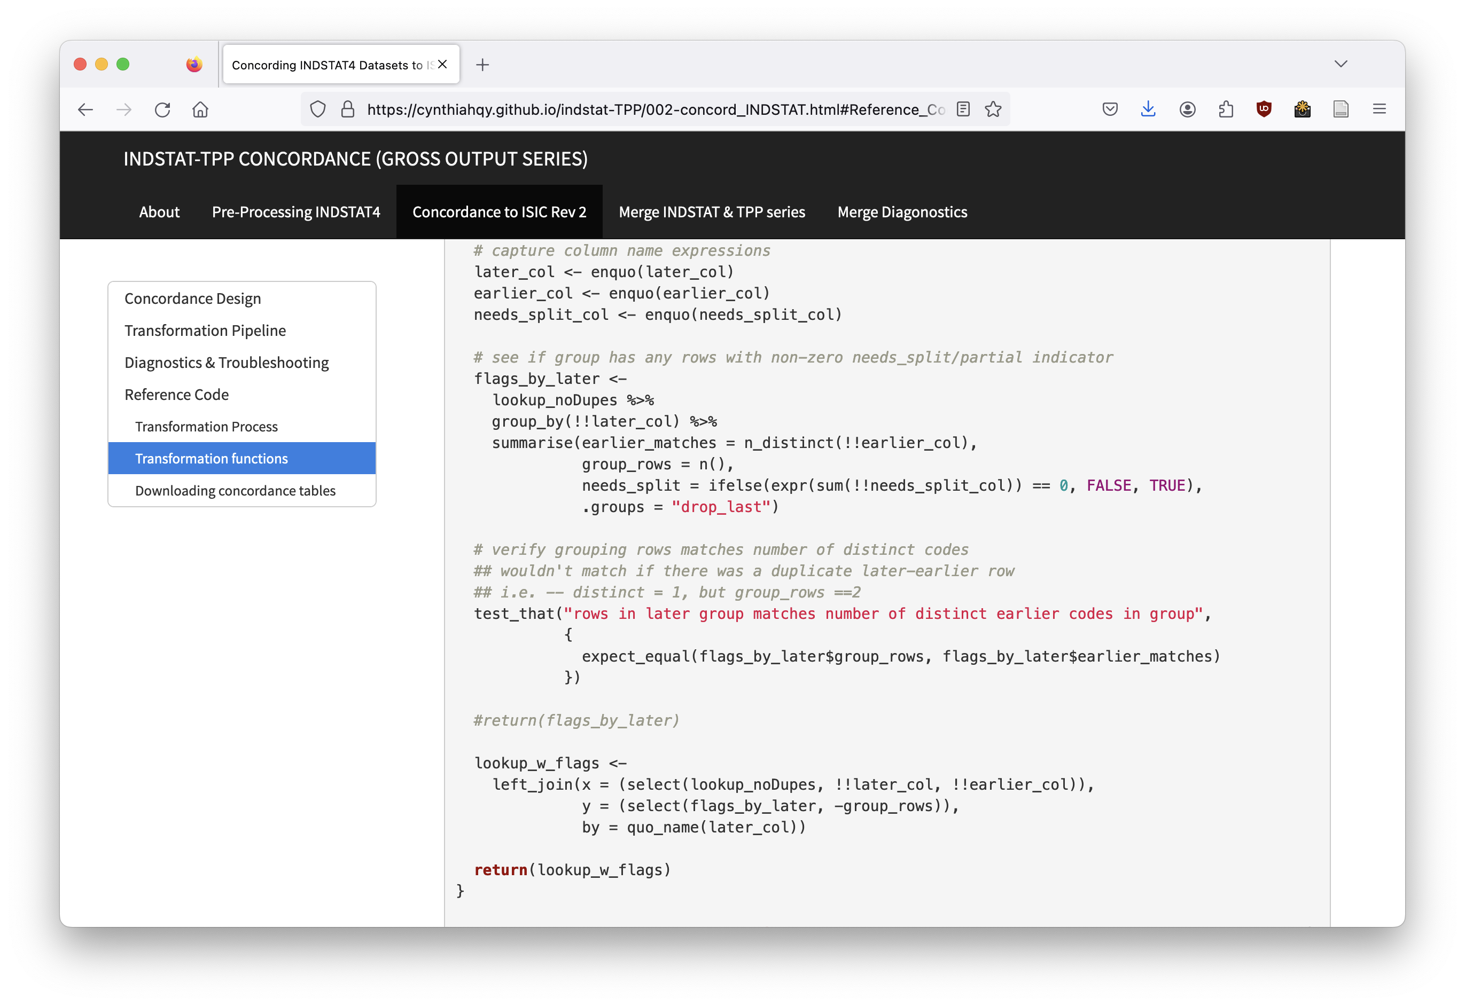
Concordance in Progress…
.
├── ISIC_concordance.Rproj
├── README.md
├── code
│ ├── fncs_cleaning.R
│ ├── fncs_concordance.R
│ ├── fncs_matchTPP.R
│ ├── fncs_probing.R
│ └── get_concordance_tables.R
├── data
│ ├── archived
│ ├── external
│ ├── final
│ ├── interim
│ └── raw
├── notebooks
│ ├── 001-clean_INDSTAT.Rmd
│ ├── 002-concord_INDSTAT.Rmd
│ ├── 003-match_TPP_INDSTAT.Rmd
│ └── 004-compare-matched.Rmd
└── reference
├── ISIC manuals
├── TPP database
├── country codes
└── unido-metadata
Notes:
I write some code, document it, keep it neat and tidy, even test things like totals and row numbers!

Slide 13
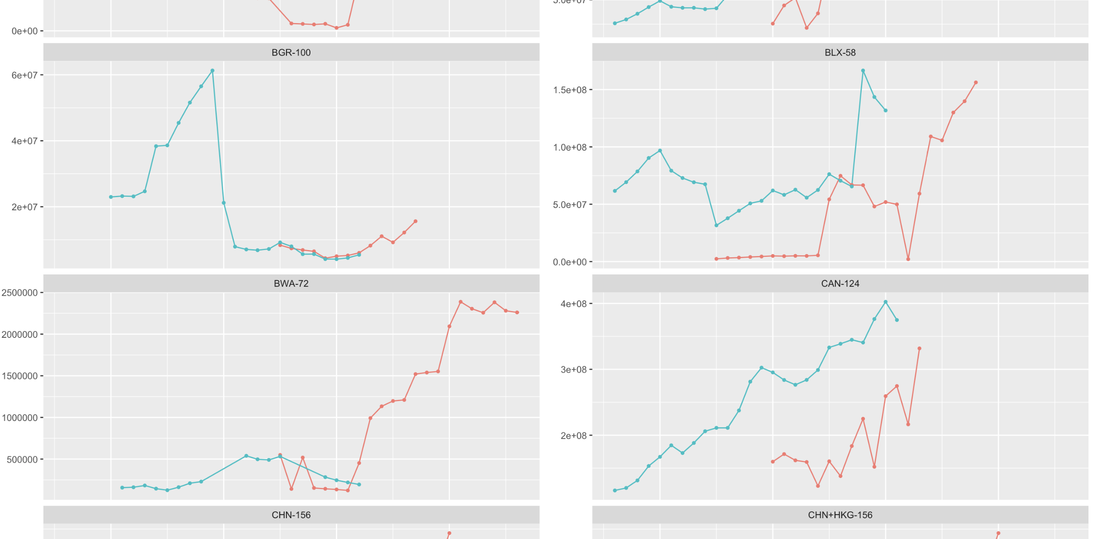
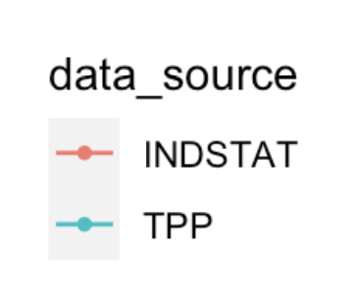
Validating data quality…
Collect
Import & Prepare
Harmonise
Validate
Notes:
I’m way past 5-10 hours at this point, so I’m ready to send the data off to be analysed and turned into some interesting economics research… I just needed to quickly check the data quality… here I’m checking that the totals before and after recoding the industry codes line up…

Slide 14
Issue found…
😱
Collect
Import & Prepare
Harmonise
Validate
ERROR!
Notes:
but they don't... I've lost huge chunks of output before and after the transformation...

Slide 15
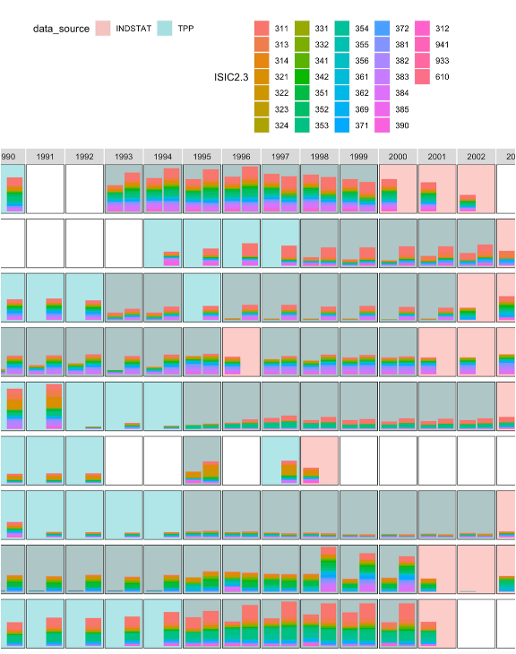
Diagnosing…
Comparing output shares and volume…
😱
Collect
Import & Prepare
Harmonise
Validate
ERROR!
Notes:
It gets worse… Comparing industry shares…

Slide 16
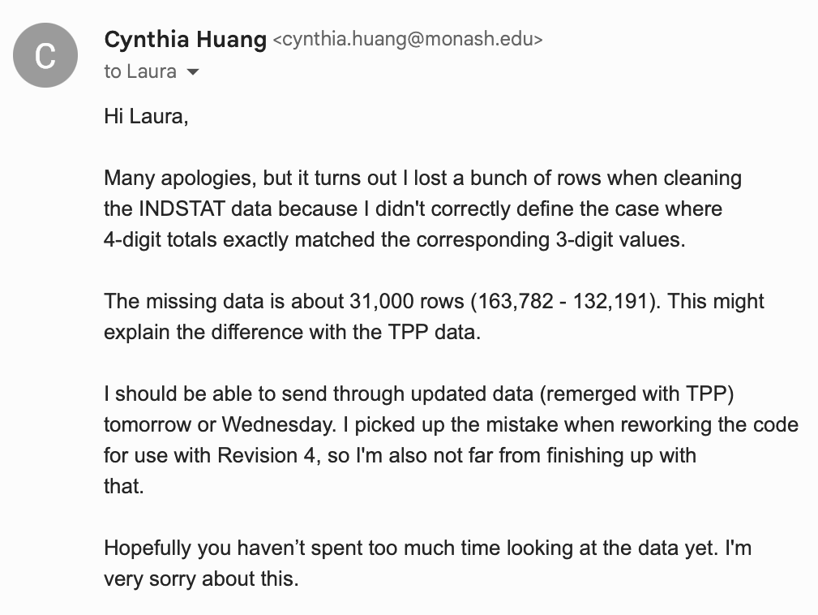
Error located…
Collect
Import & Prepare
Harmonise
Validate
ERROR!
Notes:
but I did some snooping and managed to find my mistake...

Slide 17
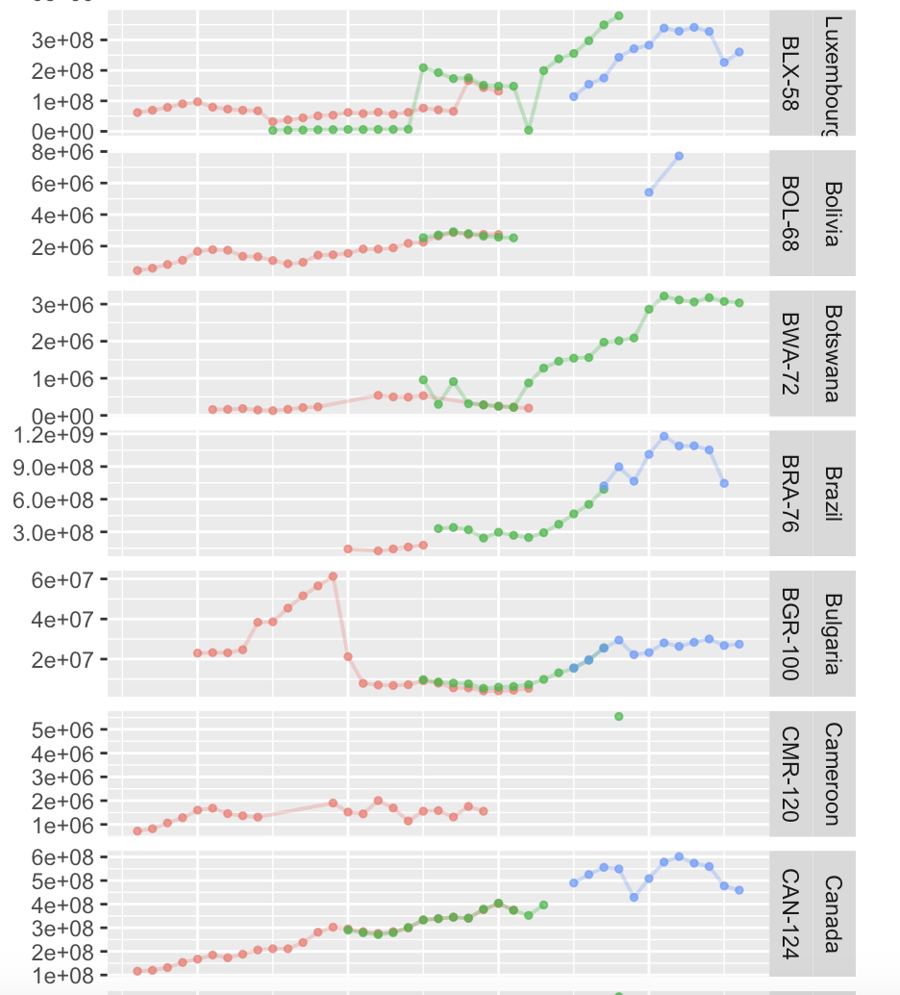
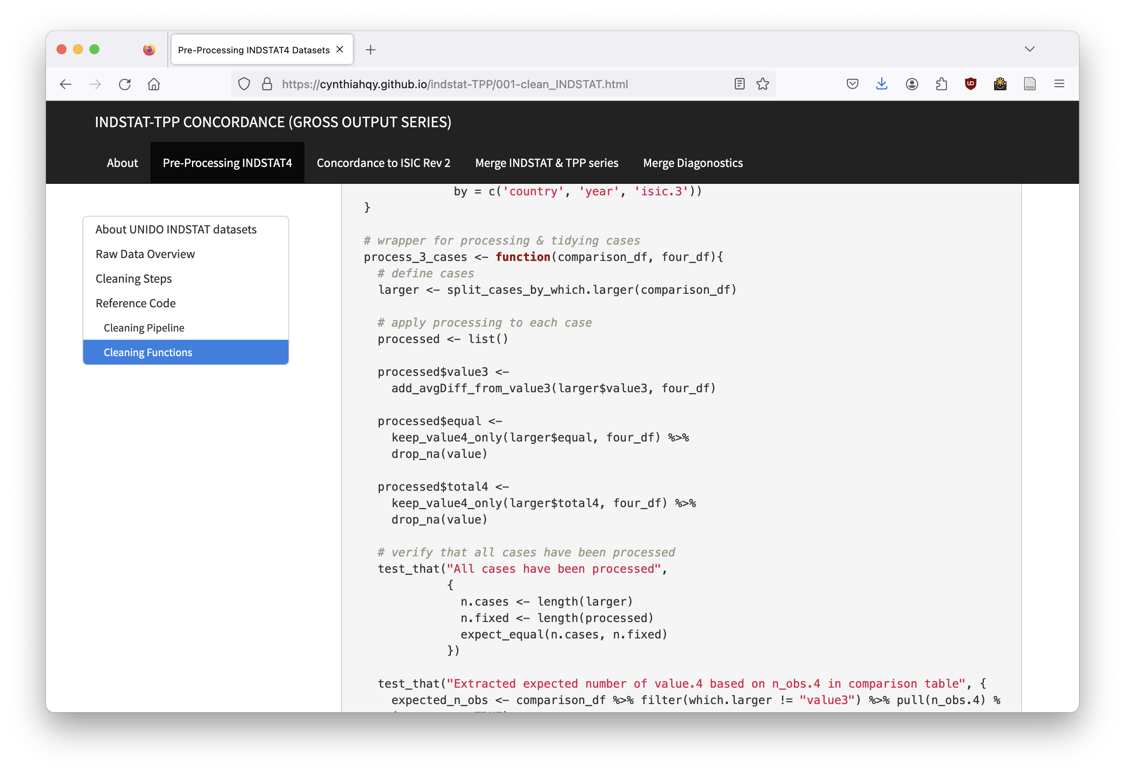
…and fixed…
Collect
Import & Prepare
Harmonise
Validate
ERROR!
Fix
Reboot
Notes:
I fixed it… mostly, to this day I still can’t tell you exactly what causes the remaining mismatch. But everyone on the team was satisfied that the data was good enough to analyse… so no harm no foul right?

Slide 18
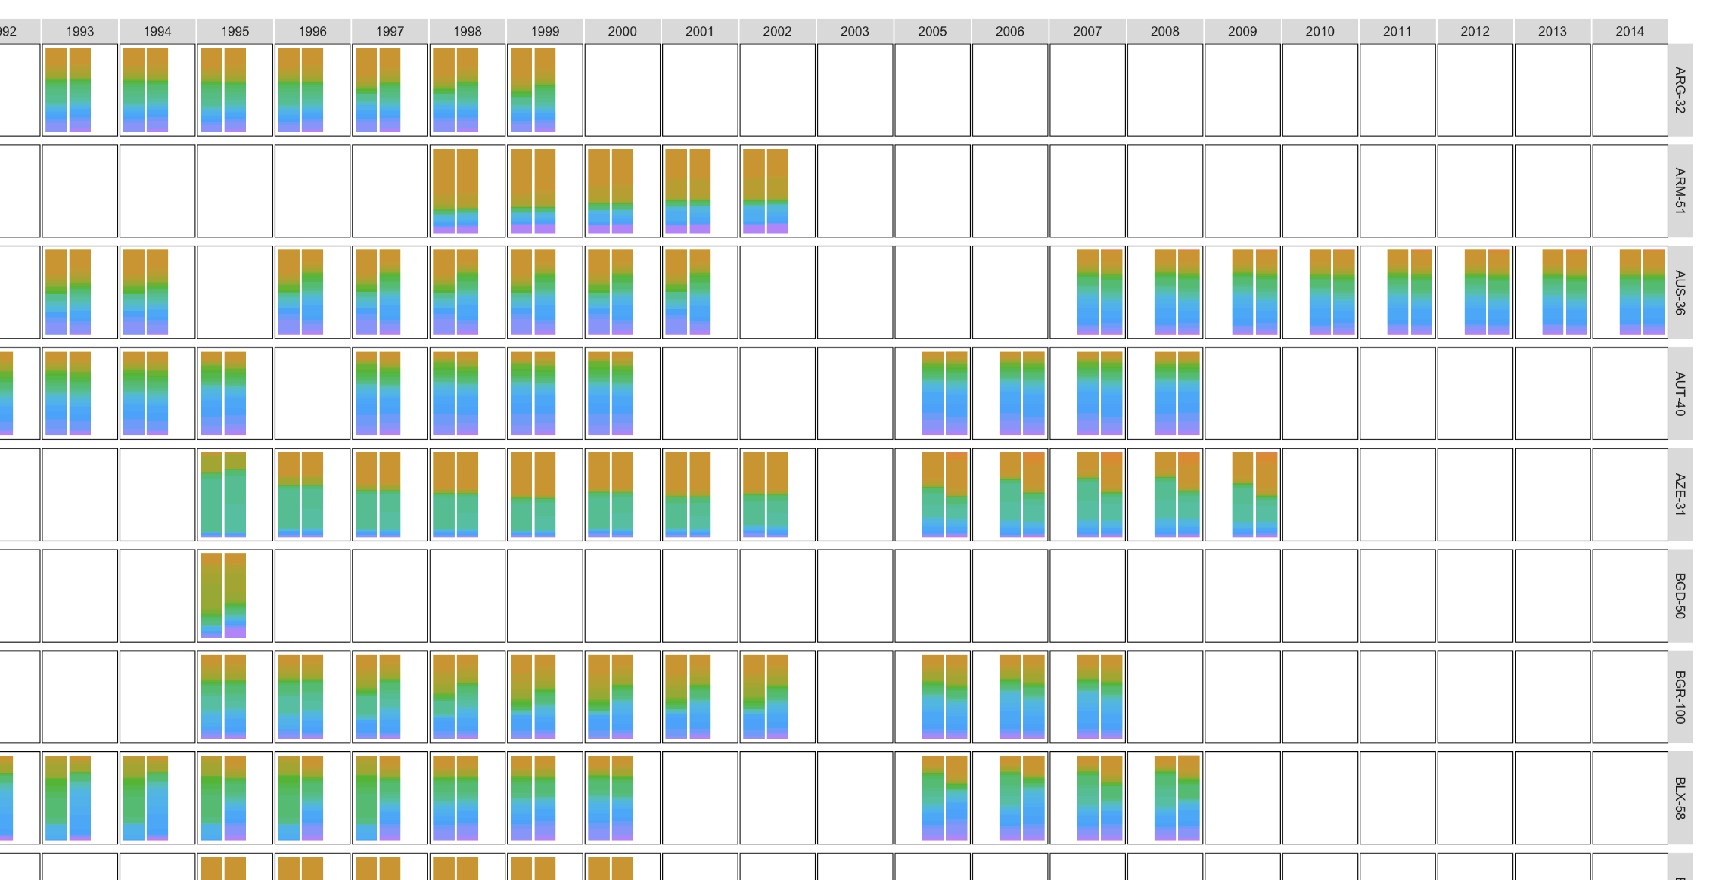
… mostly?
Collect
Import & Prepare
Harmonise
ERROR!
Validate
Fix
Reboot
Happily Research After…?
Notes:
The shares don’t all line up, and to this day I don’t know why --- I suspect multi-step transformation… But it was good enough for analysis… I guess?

Slide 19
Lessons Questions for next time?
Is there a better way to harmonise data?
Why don’t we try different mappings?
What’s actually happening to data through multiple concordance steps?
What if we didn’t have ground truth to compare with?
Notes:
Well not quite, this project left me with a lot of questions…

Slide 20
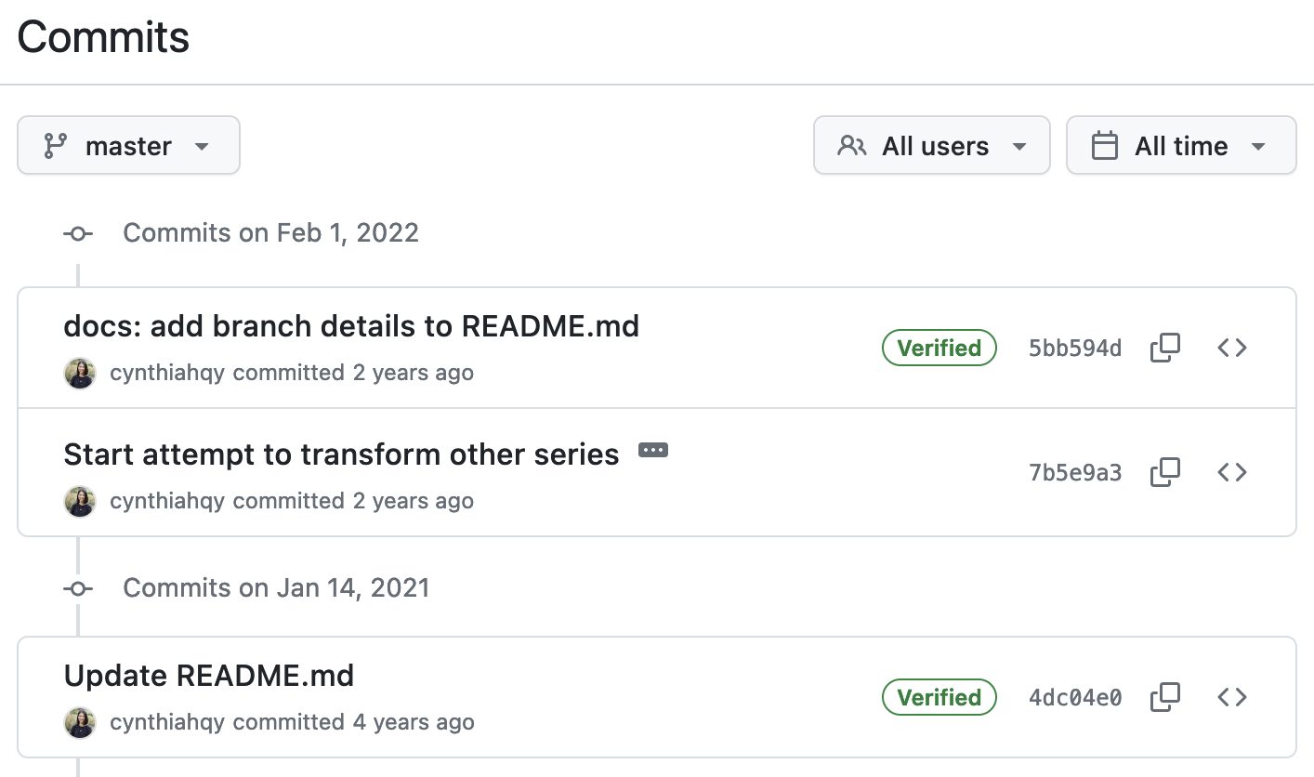
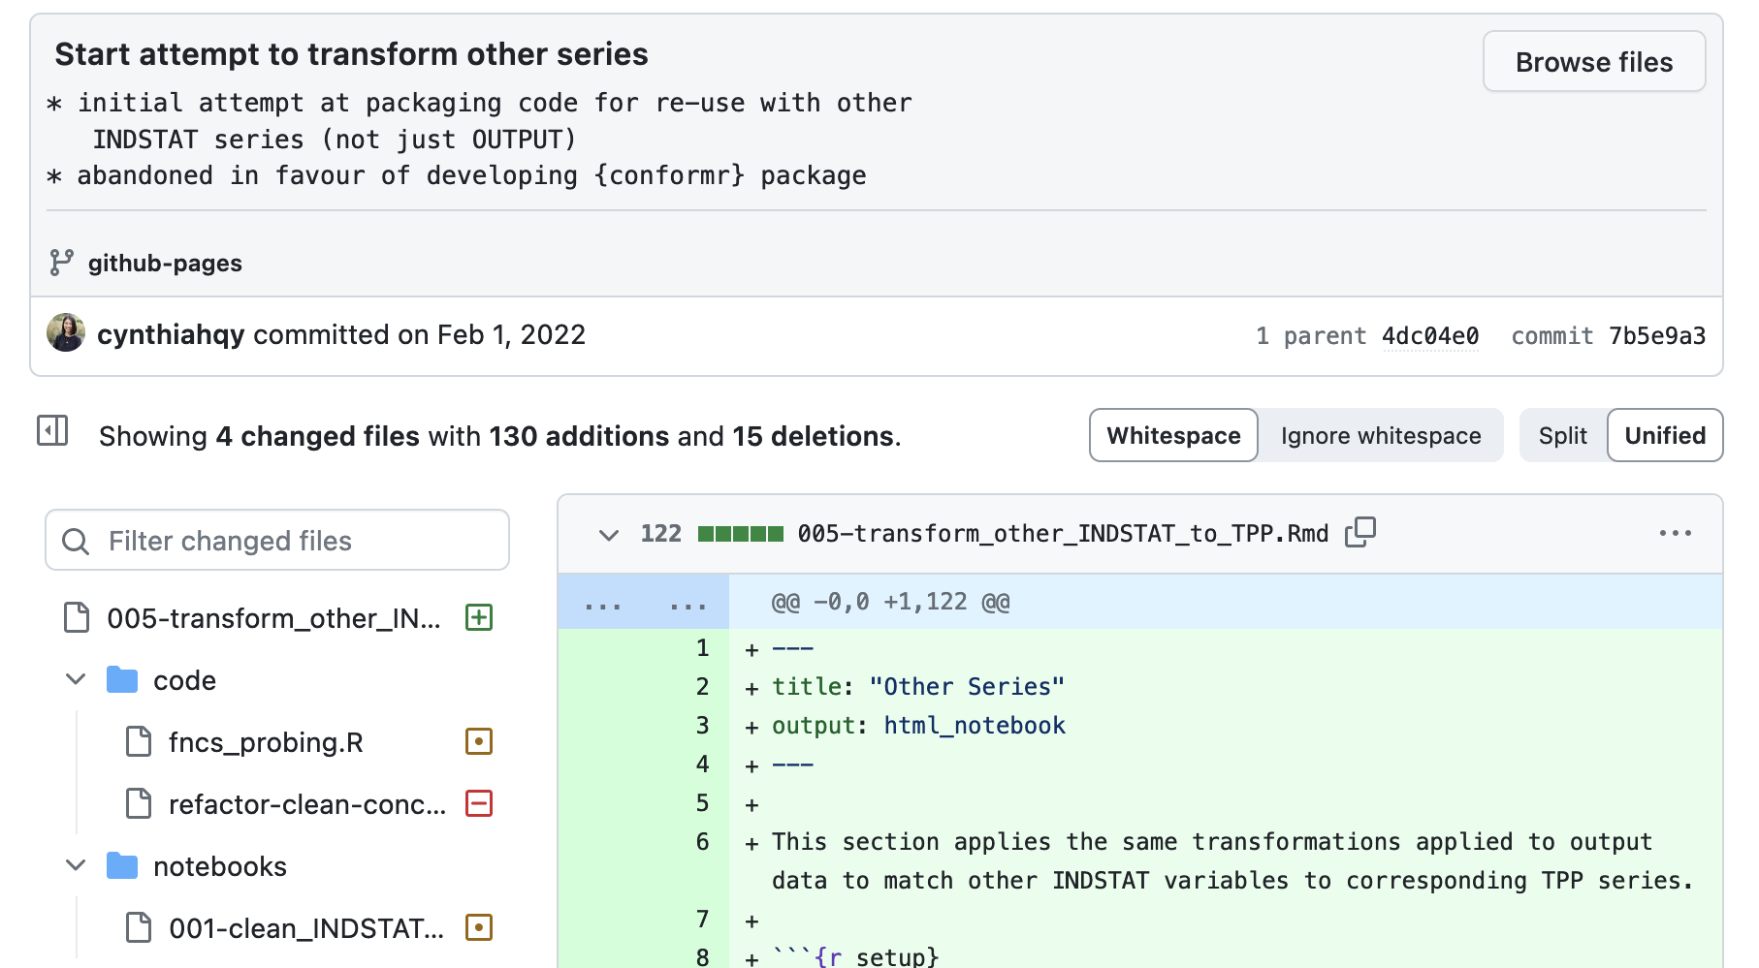
Rebooting…? FAILED
Collect
Import & Prepare
Harmonise
ERROR!
Validate
Fix
Reboot
Happily Research After…?

Slide 21
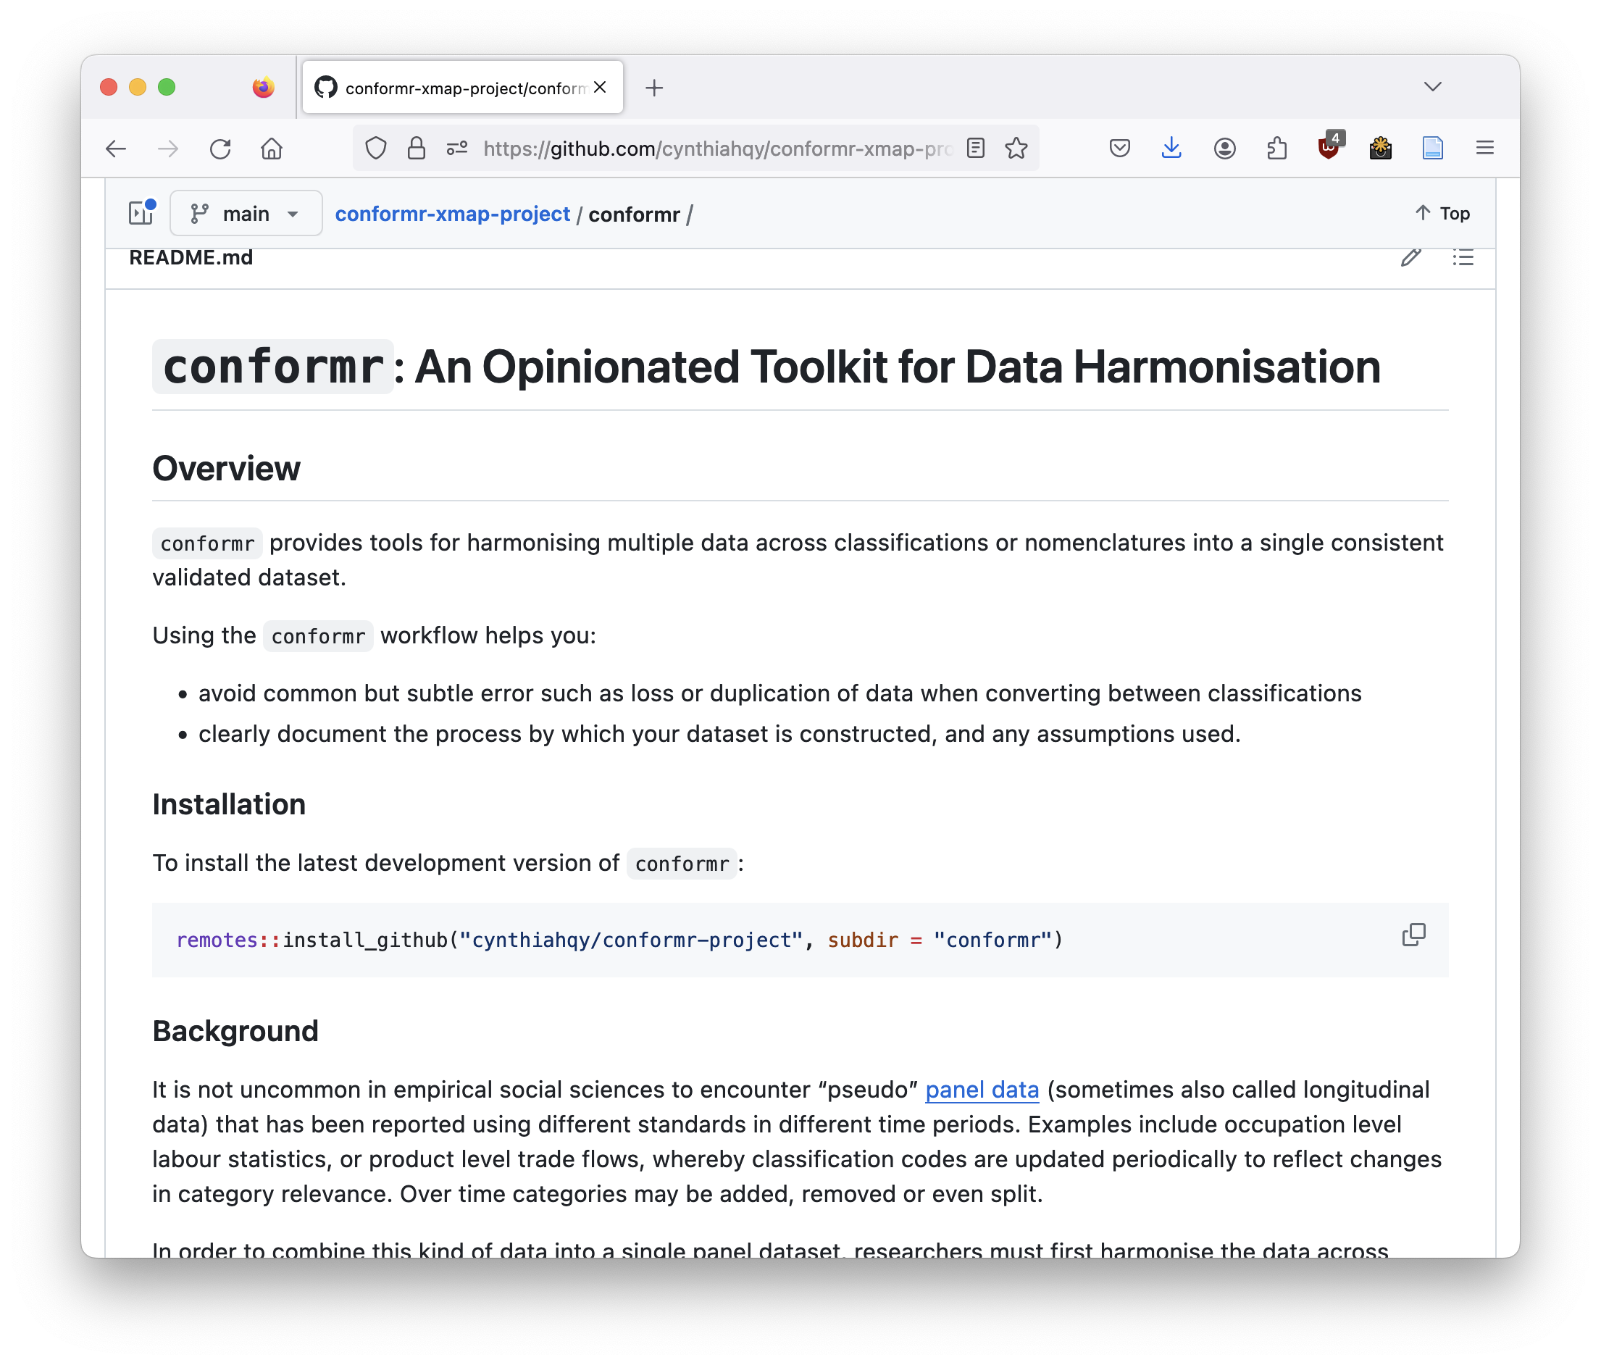
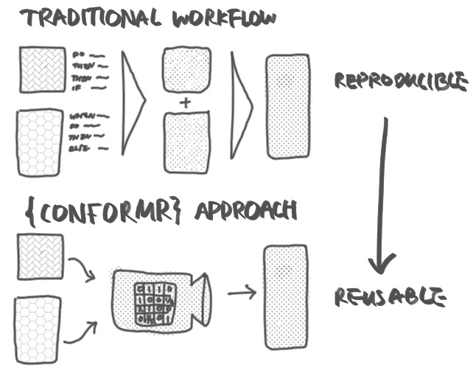
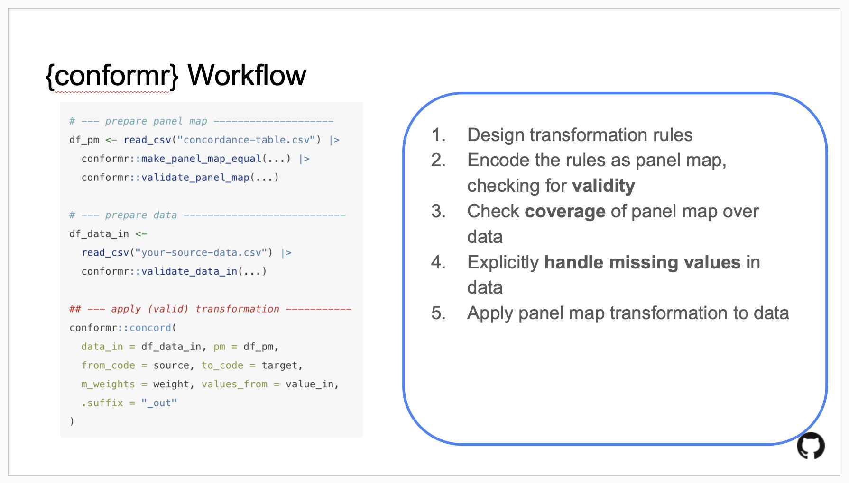
TRY: workflow 2.0?
Collect
Import & Prepare
Harmonise
ERROR!
Validate
Fix
Reboot
Happily Research After…?
Notes:
Isn’t there a better way? → guardrails in the form of a package; domain agnostic

Slide 22
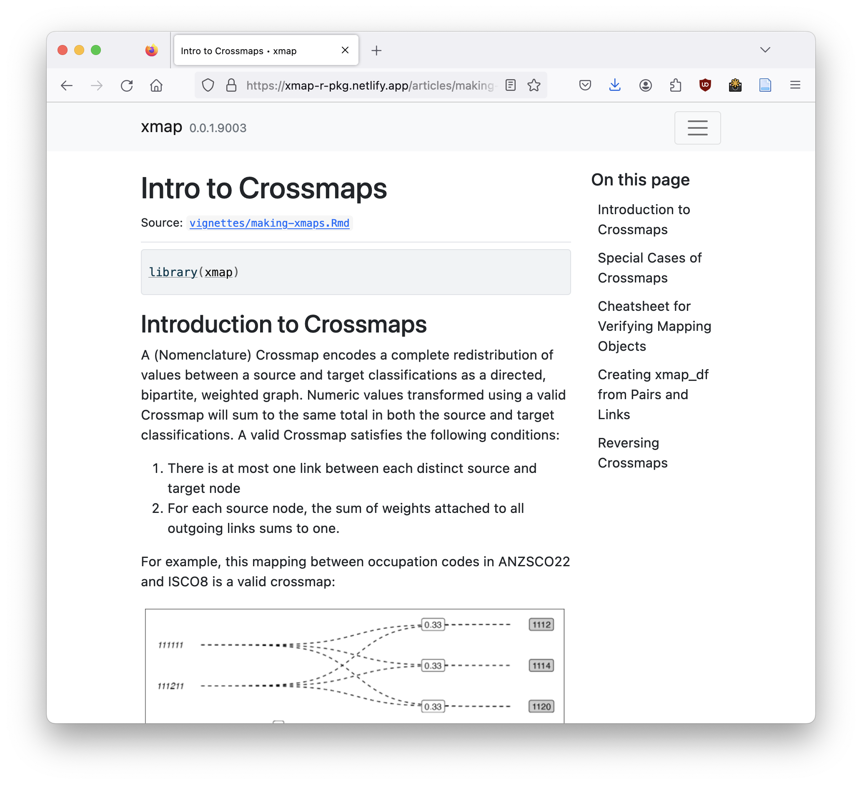
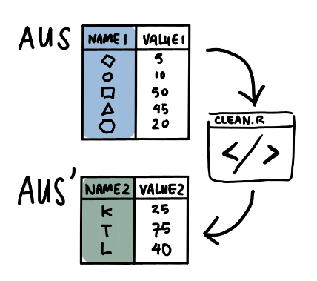
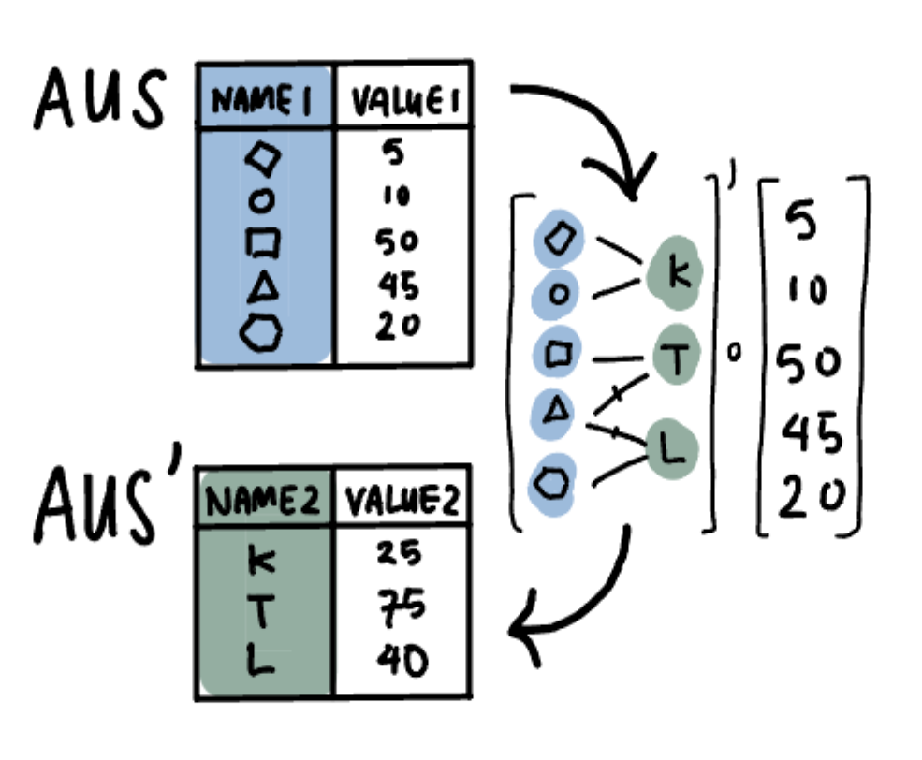
EXCEPT: formal objects not scripts?
Collect
Import & Prepare
Harmonise
ERROR!
Validate
Fix
Reboot
Happily Research After…?
Notes:
This lead me to start thinking about abstracting and formalizing operations in ex-post harmonization… inspired in large part by Hadley’s work

Slide 23
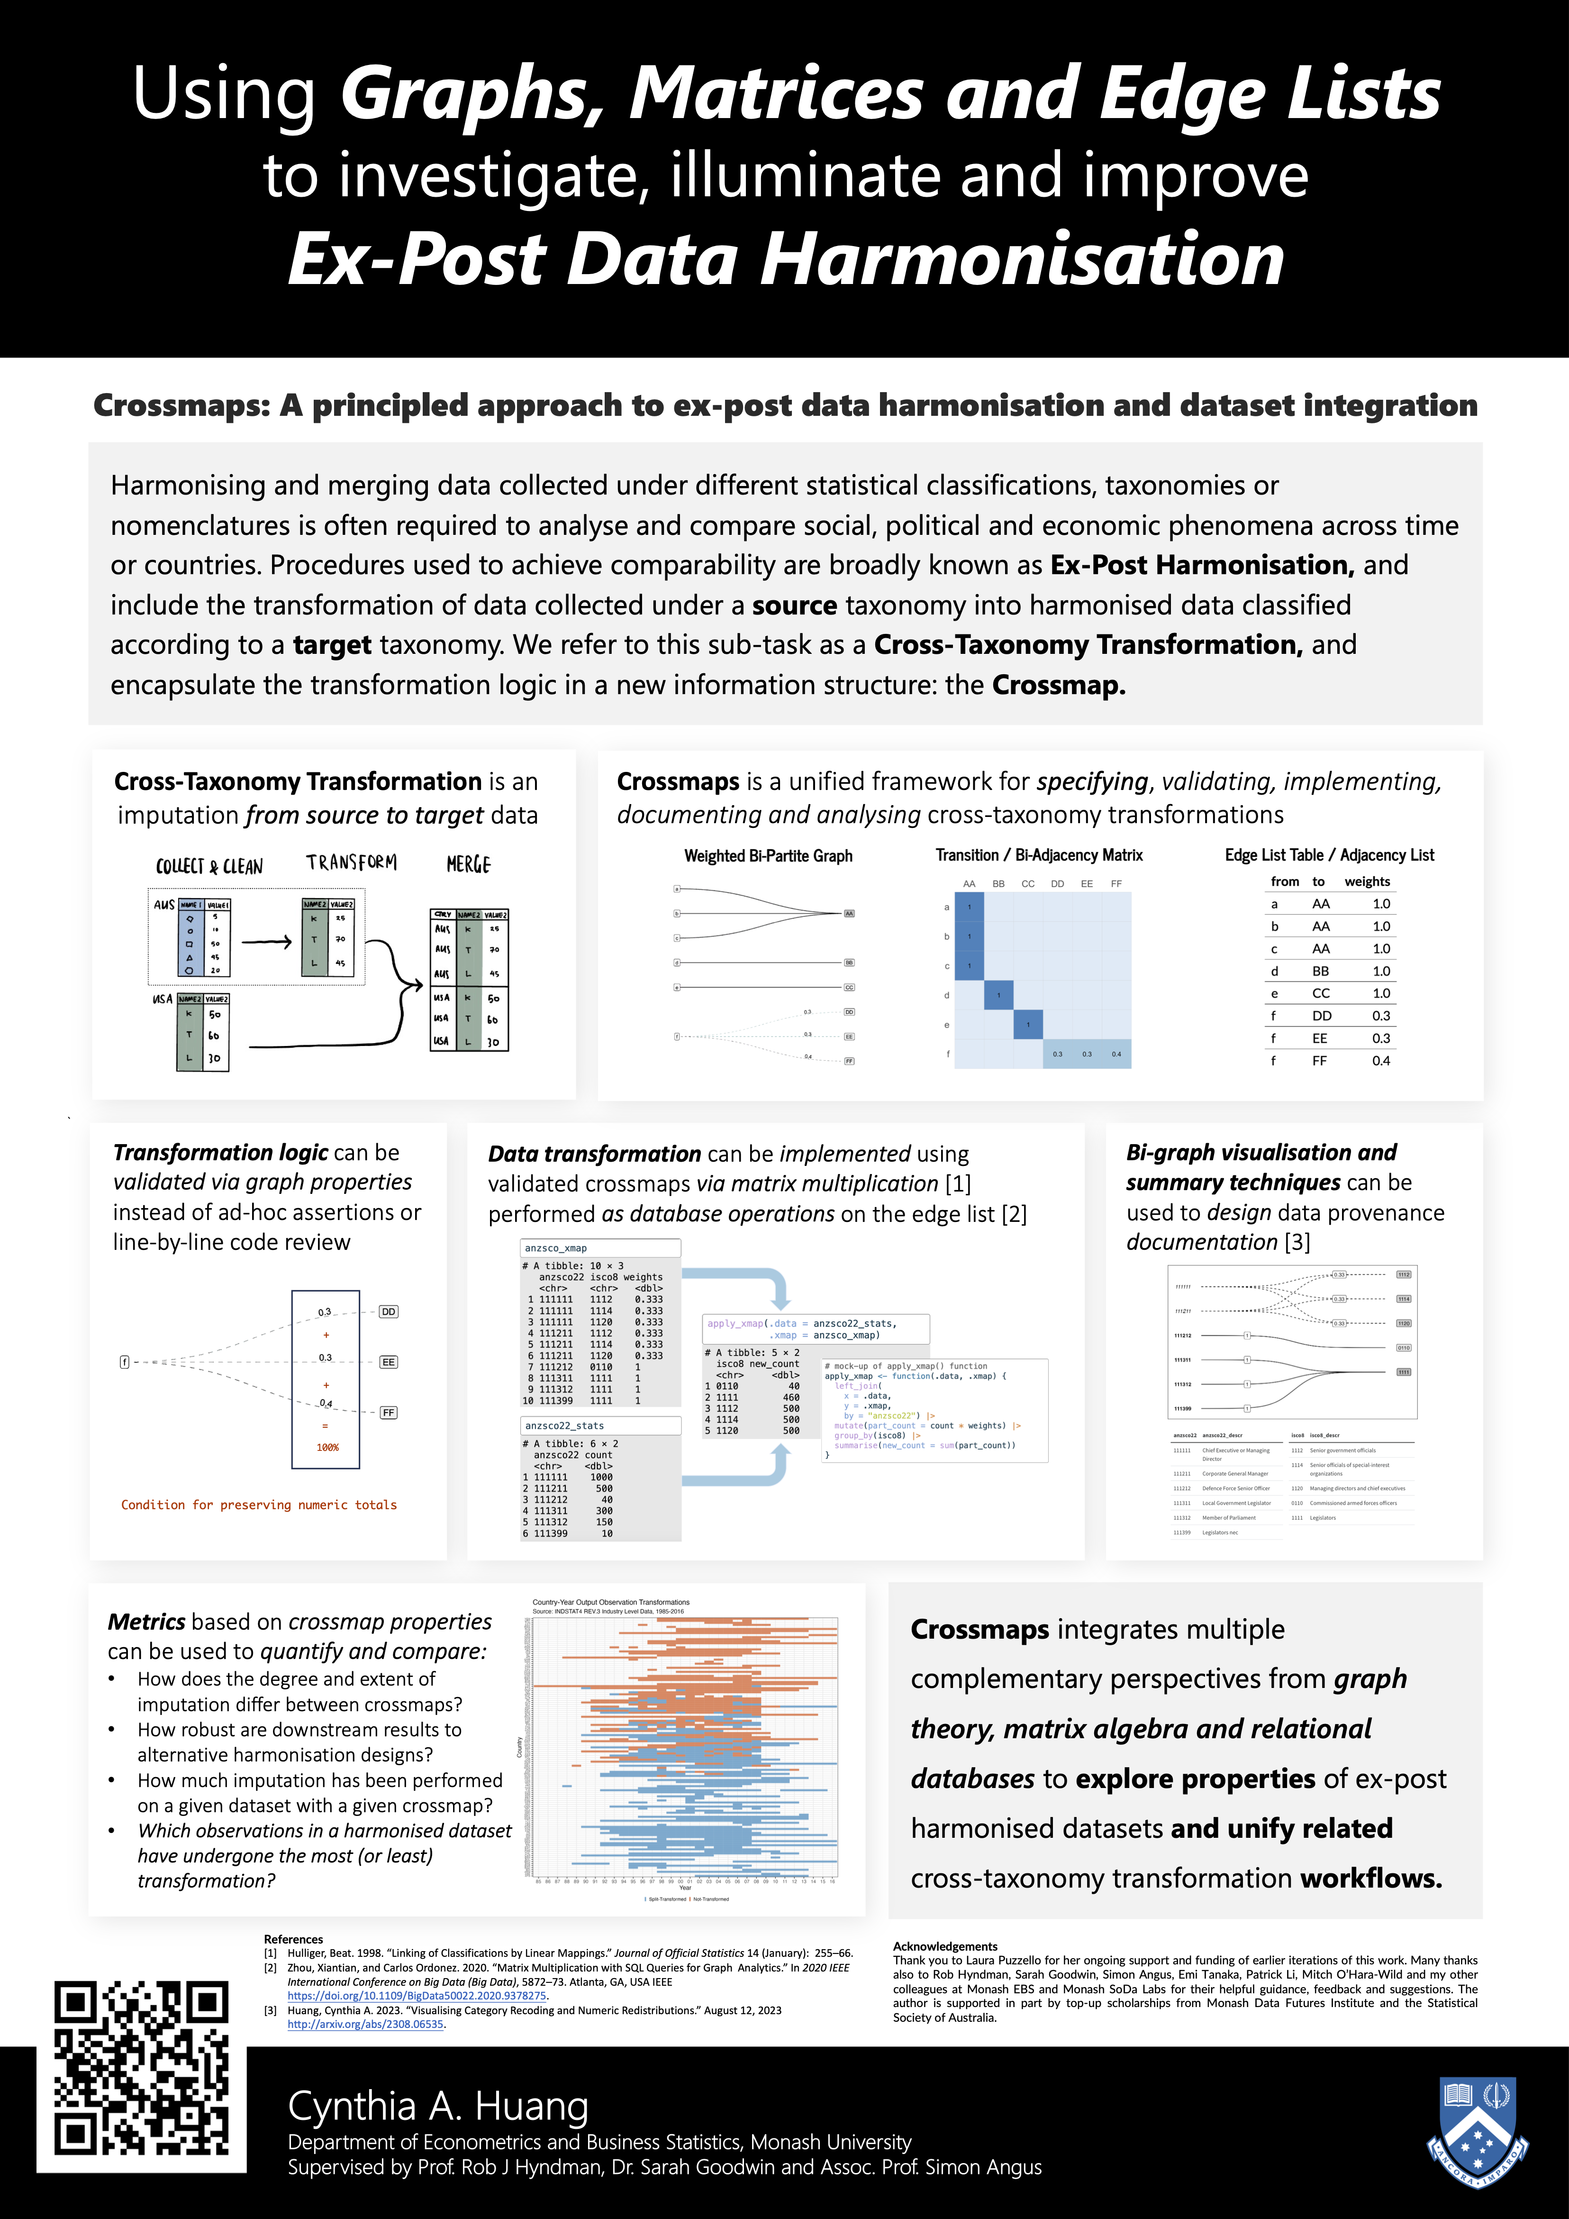
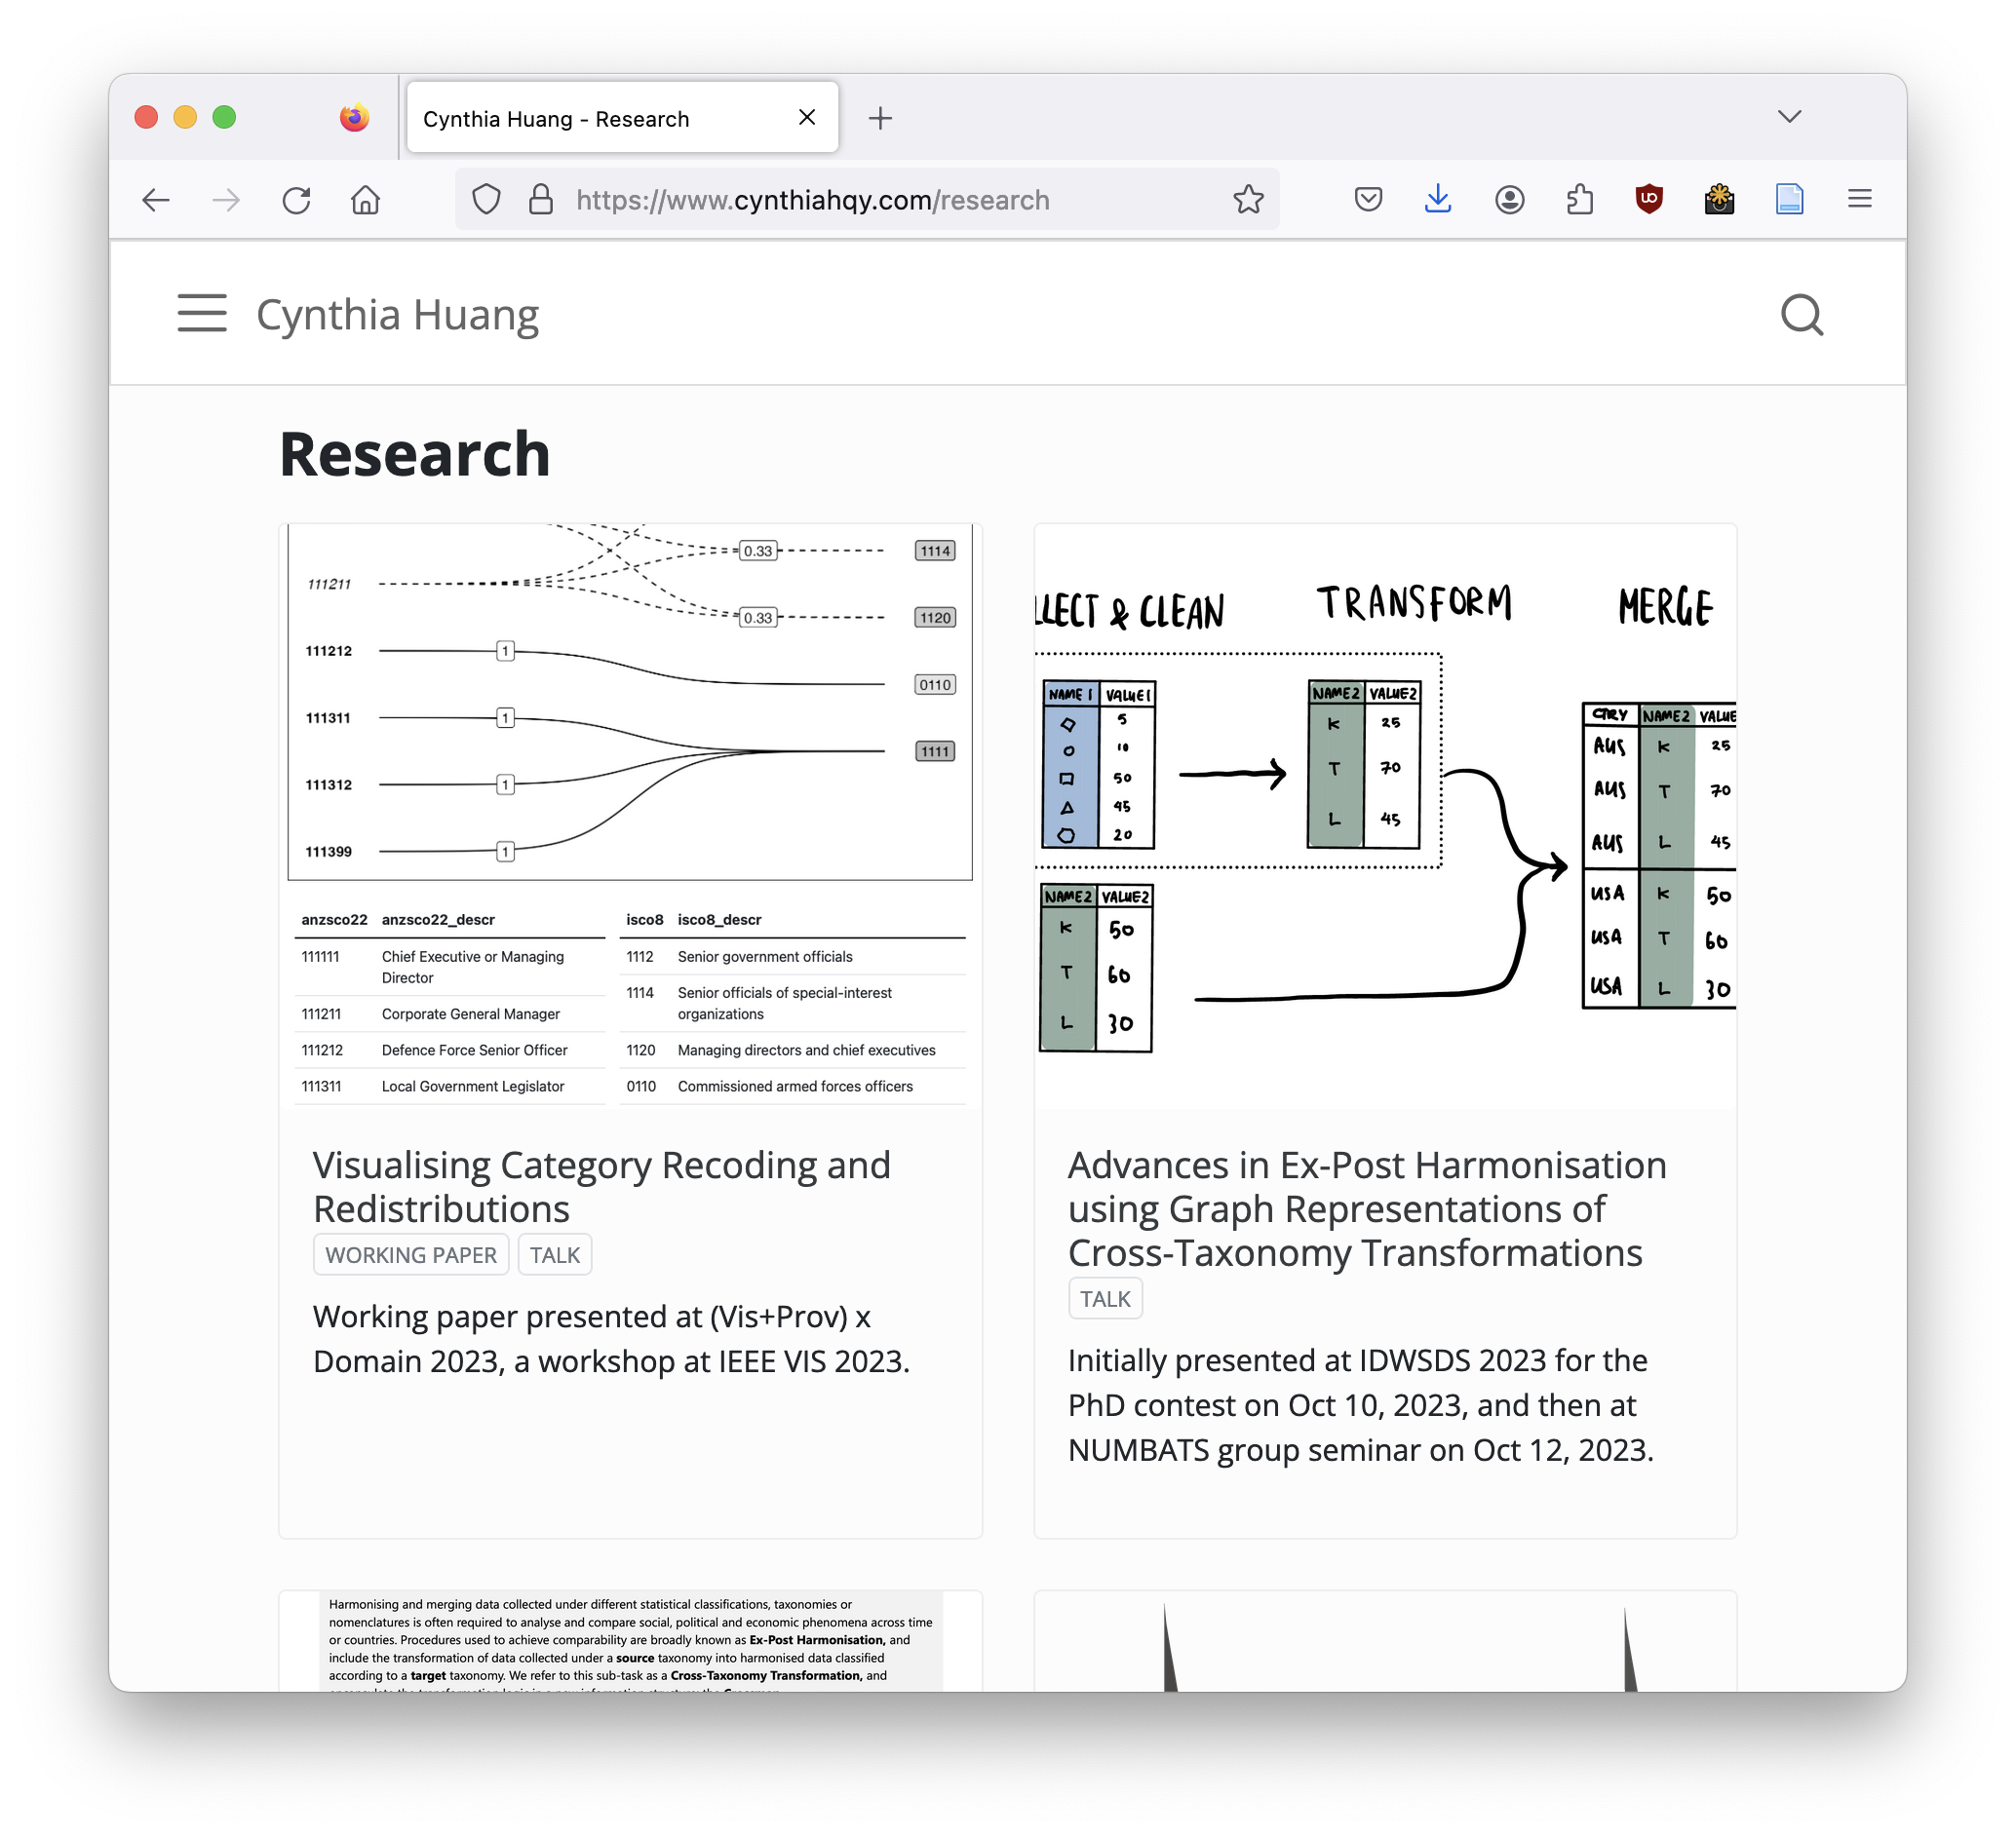
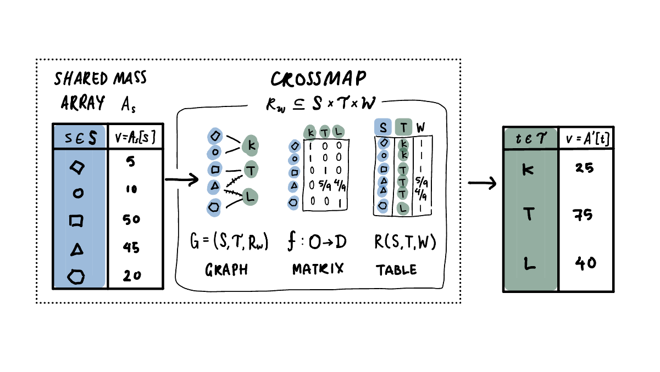
Answers… in my thesis?
Collect
Import & Prepare
Harmonise
ERROR!
Validate
Fix
Reboot
Happily Research After…?
Notes:
I don't have time to go into details, but what started out as trying to write a package with some simple safeguards to prevent similar data mishaps turned into a whole chapter exploring those questions and coming new abstractions and formalisations to understand how to design those safeguards

Slide 24
Thanks for listening!
Talk to me: @cynthiahqy / cynthia.huang@monash.edu
Learn more: cynthiahqy.com/research

